Slide 1
Risk Adjustment Images

Slide 2
Source images for STU2

Slide 3





Workflow for Medicare Advantage Population
Payer sends risk coding gap report to provider group
Provider Group
Patient
CMS allows payer to offer MA plan
Payer
Provider group may schedule a visit with the patient
Payer sends codes to CMS for use in calculating appropriate monthly member premium
Provider
submits accurate diagnoses to payer
Patient comes in and the appropriate codes get captured

Slide 4


Updated during STU1 ballot reconciliations: Figure 1-4 (Home page)
$ra.coding-gaps
Provider
Payer
Risk Adjustment Coding Gap MeasureReport
Notes:
Updated for STU2
Changed $report to $ra.coding-gaps, shortened the height, changed the word Reports to MeasureReport
Used for risk-adjustment-gaps-workflow.png
2/8/2022: Updated during ballot reconciliations as proposed resolutions
Removed the word Example
Figure is now Figure 1-4 instead of Figure 1-3

Slide 5
Updated during STU2 ballot : Figure 2.2-1 (General Guidance
MeasureReport Query
Provider
Payer
Bundle(searchset) from MeasureReport Query
Notes:
Updated for STU2
Changed $report to $ra.coding-gaps, shortened the height, changed the word Reports to MeasureReport
Used for risk-adjustment-gaps-workflow.png
2/8/2022: Updated during ballot reconciliations as proposed resolutions
Removed the word Example
Figure is now Figure 1-4 instead of Figure 1-3

Slide 6
New Figure 1-3 created during ballot reconciliations
POST
Risk Adjustment Coding Gap MeasureReport
Payer
$ra.coding-gaps
Provider
Notes:
Payer is the Client, it initiates the request and pushes the report
(note: Provider’s FHIR Server receives the report)
2/8/2022:
1. Added POST above

Slide 7
New Figure 1-3 created during ballot reconciliations
POST
Bundle (searchset) from MeasureReport Query
Payer
MeasureReport Query
Provider
Notes:
Payer is the Client, it initiates the request and pushes the report
(note: Provider’s FHIR Server receives the report)
2/8/2022:
1. Added POST above

Slide 8

Actors for $ra.resolve-cc-gaps
POST
Risk Adjustment Coding Gap Bundle
Risk Adjustment Coder
$ra.resolve-coding-gaps
Payer

Slide 9
Figure: Lifecycle Phases – Nov, 2023 update
Query
(coding gap reports)
Generation
(coding gap reports)
Provider
Payer Patient Records
Provider Patient Records
Submit Data to Payer
(e.g., medical record as clinical evaluation evidence)
Payer
Notes:
Updated 3/15/2023 to address Cody’s comment

Slide 10
Figure: Submit Data to Payer
$submit-data
Risk Adjustment Data Exchange MeasureReport
Resources for clinical evaluation evidence
Provider
Payer
Notes:
Updated 3/15/2023 to address Cody’s comment

Slide 11
New Figure: Lifecycle Phases
Query
(coding gap reports)
Generation
(coding gap reports)
Provider
Payer Patient Records
Provider Patient Records
Task
Payer
Risk Adjustment Coder
Remediation
(gap closure/ invalidation/net-new)
Task
Notes:
Updated 3/15/2023 to address Cody’s comment

Slide 12
New Figure: Lifecycle Phases
Query
(coding gap reports)
Generation
(coding gap reports)
Provider
Payer Patient Records
Provider Patient Records
Task
Payer
Risk Adjustment Coder
Remediation
(gap closure/ invalidation)
Task
Notes:
Updated 3/15/2023 to address Cody’s comment

Slide 13
Report Annotation (report-annotation-overview-provider.png)
Adds Condition
Category Remarks
Generation
(coding gap reports)
Query
(coding gap reports)
Provider Patient Records
Condition Category Remark added to coding gap report
Payer Patient Records
Provider has visit with patient
Provider, EMR, Provider’s Risk Adjustment Coder
Patient
Payer
Report with Condition Category Remark(s) posted to Payer
Notes:
Updated payer to Payer

Slide 14
Report Annotation (report-annotation-overview-provider.png)
Report with Condition Category Remark(s) posted to Payer
Generation
(coding gap reports)
Query
(coding gap reports)
Provider Patient Records
Condition Category Remark added to coding gap report
Payer Patient Records
Provider has visit with patient
Provider, EMR, Provider’s Risk Adjustment Coder
Patient
Payer
Adds Condition
Category Remarks
Notes:
Updated payer to Payer

Slide 15
Report Annotation (report-annotation-overview-payer.png)
Report with Condition Category Remark(s) posted on Payer’s System
Generation
(coding gap reports)
Condition Category Remark added to coding gap report
Query
(coding gap reports)
Payer Patient Records
Payer’s System, Payer’s Risk Adjustment Coder
Payer
Notes:
Updated payer to Payer

Slide 16
Three Stages Overview - Generation
Generation
(coding gap reports)
Payer Patient Records
Remediation
(gap closure/ invalidation)
Payer
Resolution
(resolve gap closure/ invalidation)
Provider Patient Records
Risk Adjustment Coder
Provider

Slide 17
Three Stages Overview - Remediation
Generation
(coding gap reports)
Payer Patient Records
Remediation
(gap closure/ invalidation)
Payer
Resolution
(resolve gap closure/ invalidation)
Provider Patient Records
Risk Adjustment Coder
Provider

Slide 18
Three Stages Overview - Resolution
Generation
(coding gap reports)
Payer Patient Records
Remediation
(gap closure/ invalidation)
Payer
Resolution
(resolve gap closure/ invalidation)
Provider Patient Records
Risk Adjustment Coder
Provider

Slide 19
DRAFT
Risk Adjustment Coder
Provider
Risk Adjustment Coding Gap Bundle
Notes:
Used for risk-adjustment-gaps-workflow.png
2/8/2022: Updated during ballot reconciliations as proposed resolutions
Removed the word Example
Figure is now Figure 1-4 instead of Figure 1-3

Slide 20
Source images for STU1

Slide 21
2021 MA Payment Year
2021 MA Payment Year
Calendar Year 2022
Concurrent RA Activities
(box enclosed by dashed line)
Member Encounters,
Data Collection and
Sweeps (2020)
Data Collection and
Payment Adjustments
(2021)
Submission Deadline
(end of Jan 2022)
2022 MA Payment Year
2022 MA Payment Year
Member Encounters,
Data Collection and
Sweeps (2021)
Data Collection and
Payment Adjustments
(2022)
Submission Deadline
(end of Jan 2023)
2023 MA Payment Year
2023 MA Payment Year
Calendar Year 2022
Clinical Evaluation Period
Member Encounters,
Data Collection and
Sweeps (2022)
Data Collection and
Payment Adjustments
(2023)
Submission Deadline
(end of Jan 2024)
Notes:
Last change Nov 14, 2018
Added to index page as first figure

Slide 22
Index page

Slide 23
Workflow for Medicare Advantage Population
Phase One
Payer Sends Risk Coding report to provider group
Provider Group
Patient
CMS allows payer to offer MA plan
Payer
Provider group may schedule a visit with the patient
Payer sends codes to CMS for use in calculating appropriate monthly member premium
Provider submits accurate diagnoses to payer
Patient comes in and the appropriate codes get captured

Slide 24
Workflow for Medicare Advantage Population
STU 1
Payer sends risk coding gap report to provider group
Provider Group
Patient
CMS allows payer to offer MA plan
Payer
Provider group may schedule a visit with the patient
Payer sends codes to CMS for use in calculating appropriate monthly member premium
Provider submits accurate diagnoses to payer
Patient comes in and the appropriate codes get captured

Slide 25
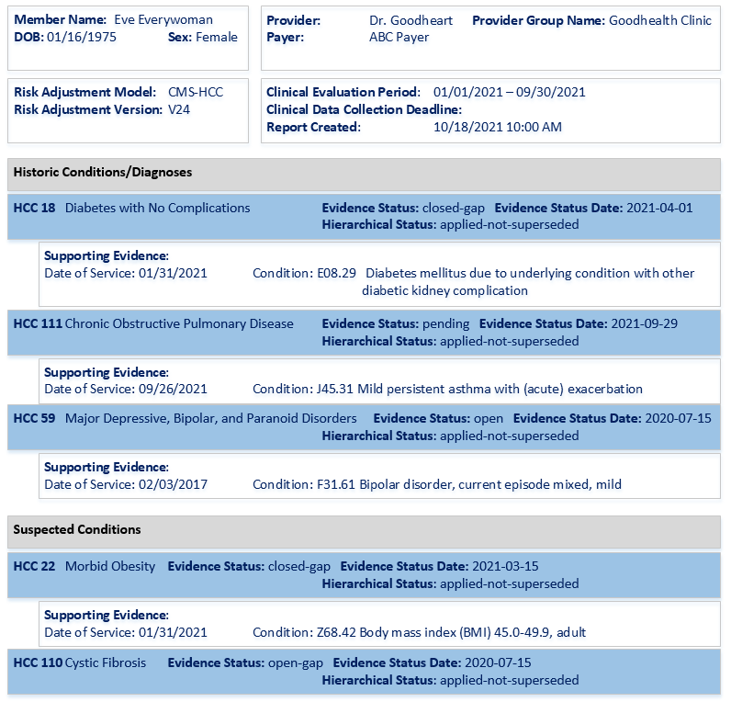
Example Risk Adjustment Report
Notes:
Source is visio,

Slide 26
Updated during STU1 ballot reconciliations: Figure 1-4 (Home page)
$cc-gaps
Provider
Payer
Risk Adjustment Coding Gap Reports
Notes:
Used for risk-adjustment-gaps-workflow.png
2/8/2022: Updated during ballot reconciliations as proposed resolutions
Removed the word Example
Figure is now Figure 1-4 instead of Figure 1-3

Slide 27
New Figure 1-3 created during ballot reconciliations
POST
Risk Adjustment Coding Gap Reports
Payer
$cc-gaps
Providers
Notes:
Payer is the Client, it initiates the request and pushes the report
(note: Provider’s FHIR Server receives the report)
2/8/2022:
1. Added POST above

Slide 28
Bundle
(searchSet)
Risk Adjustment Model Measure
CMS-HCC V24
entry
measure
US Core Encounter
DOS: 01/31/2021
Risk Adjustment
Coding Gap Report
entry
evaluatedResource
.group[1]
.code: 18 Diabetes with Chronic Complications
historic
closed-gap
applied-not-superseded
US Core Condition
E08.29 Diabetes mellitus due to underlying condition with other diabetic kidney complication
evaluatedResource
US Core Patient
Eve Everywoman
DOB: 01/16/1975
subject
.group[4]
.code: 22 Morbid Obesity
suspected
closed-gap
applied-not-superseded
US Core Condition
Z68.42 Body mass index (BMI) 45.0-49.9, adult
evaluatedResource
reporter
.group[2]
.code: 111 Chronic Obstructive Pulmonary Disease
historic
closed-gap
applied-not-superseded
US Core Organization
ABC Payer
US Core Condition
J45.31 Mild persistent asthma with (acute) exacerbation
evaluatedResource
evaluatedResource
US Core Encounter
DOS: 09/26/2021
Notes:
Note: 1-16-2022 corrected HCC 18 from Diabetes with No Complication to Diabetes with Chronic Complication
3/16/2023: updated Risk Adjustment Coding Gap Report Bundle to “Bundle (searchSet)

Slide 29
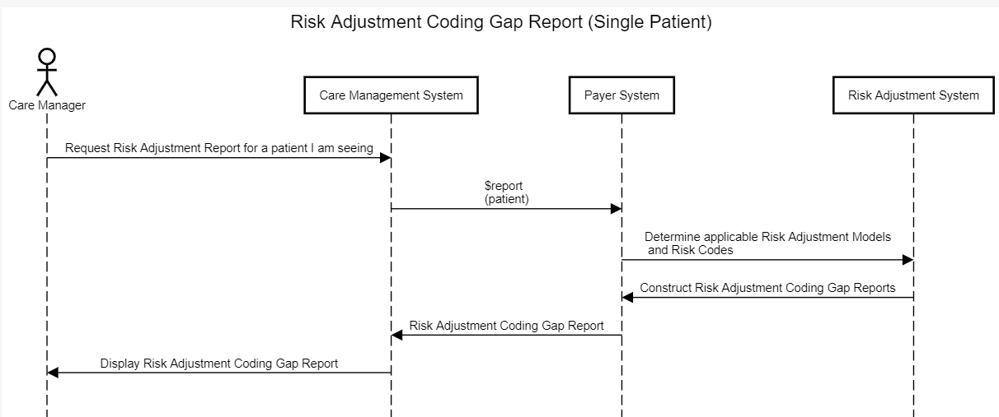
Risk Adjustment Coding Gap Report (Single Patient)
Notes:
Generated using /sequencediagram.org
Input file in image/source/Risk-Adjustment-Coding-Gap-Report-Single-Patient.txt
for STU2 image/source/Risk-Adjustment-Coding-Gap-Report-Single-Patient-STU2.txt

Slide 30
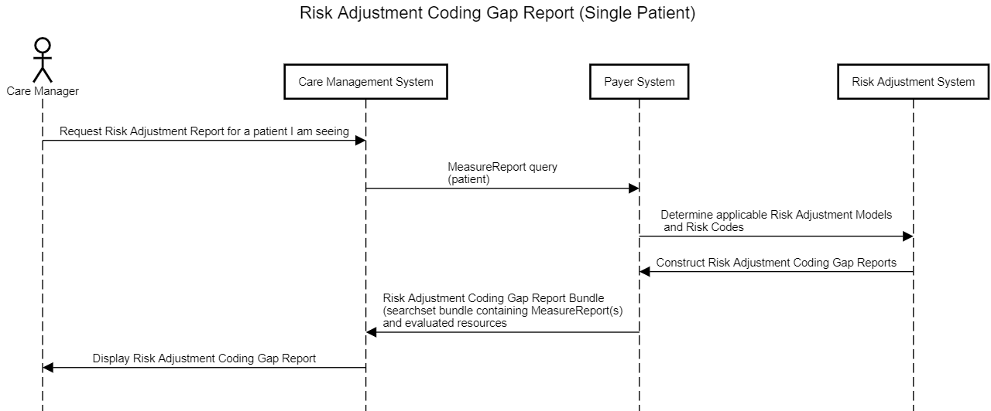
Risk Adjustment Coding Gap Report (Single Patient) Report Query Figure 3-1
Notes:
Generated using /sequencediagram.org
Input for STU2 image/source/Risk-Adjustment-Coding-Gap-Report-Single-Patient-STU2.txt

Slide 31
Multiple Measure Reports

Slide 32
Risk Adjustment Resources
RA Measure
CMS HCC v24
measure
US Core Encounter
20210401
RA Bundle
RA Measure Report #1
2 HCC, 189 & 19
evaluateResources
entry
US Core Observation
A1C of 9.4/20210401
group[1].extension-historicDiagnosis
section.entry
entry
US Core Condition
ICD
Z89.511/20210401
patient
US Core Patient*
Age 63
RA Composition
US Core Condition
M06252 Rheumatoid bursitis, left hip 12/042021
subject
section.focus
MedicationDispense
20210323
custodian
group[1].extension-historicDiagnosis
RA Measure Report #2
RX HCC
*US Core Patient is also pointed to by all RA Measure Reports, US Core Procedure, US Core Lab Observations, US Core Condition, etc
evaluateResources
US Core Organization
(example Payer)
Medication
measure
Medication
Rinvoq (Upadacitinib)
RA Measure
Rx HCC v05

Slide 33
HCC189: Amputation Status, Lower Limb/Amputation Complications
Initial Population
Denominator
Open/Closed historic and suspected gaps, and closed net-new gaps
Numerator
Denominator Exclusions
Closed historic, suspected, and
net-new gaps

Slide 34
HCC189: Amputation Status, Lower Limb/Amputation Complications
HCC 189 Initial Population
Enrolled Medicare Advantage members
HCC 189 Denominator
Open/Closed historic and suspected gaps, and Closed net-new gaps
HCC 189 Numerator
Denominator Exclusions
Acquired absences of fingers and toes:
Closed historic, suspected, and net-new gaps
Congenital absences of fingers and toes

Slide 35
Old versions of figures – not used

Slide 36
Balloted: Figure 1-3 (Home page)
$report
Client
(example Provider)
Server
(example Payer)
Risk Adjustment Coding Gap Reports
Notes:
Used for risk-adjustment-gaps-workflow.png

Slide 37
For Guidance Page
$report
Client
(example Provider)
Server
(example Payer)
Risk Adjustment Care Gap Reports
Notes:
Used for risk-adjustment-gaps-workflow.png

Slide 38
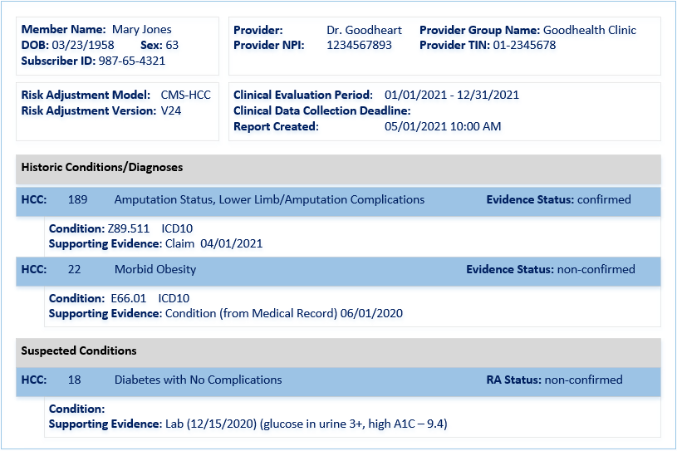
Example Risk Adjustment Report
Notes:
Source is visio,

Slide 39
Risk Adjustment Model Measure
CMS HCC v24
US Core Organization
ABC Payer
measure
reporter
US Core Patient*
Mary Jones
DOB: 03231958
Risk Adjustment Coding Gap Report
subject
US Core Condition
Z89.511 Acquired absence of right leg below knee
20210401
.Group[1]
.code – 189
Amputation Status, Lower Limb
Historic
confirmed
group[1].extension-historicDiagnosis
US Core Encounter
04012021
US Core Condition
E66.01 Morbid obesity 06012020
evaluateResources.
extension-
groupReference
.Group[2]
.code – 019
Morbid obesity
Historic
Non-confirmed
group[2].extension-historicDiagnosis
US Core Observation
Hemoglobin A1C of 9.4
20201215
evaluateResources.extension-groupReference
.Group[3]
.code – 022
Diabetes with no complications
Suspected
Non-confirmed
*US Core Patient is also pointed to by all RA Measure Reports, US Core Procedure, US Core Lab Observations, US Core Condition, etc.
evaluateResources.extension-groupReference
US Core Observation
Urine glucose 3+ 20201215
Notes:
Resource Graph to match Report

Slide 41
Three Stages Overview
Query
(coding gap reports)
Task
Generation
(coding gap reports)
Remediation
(gap closure/ invalidation/net-new)
Payer Patient Records
Provider Patient Records
Risk Adjustment Coder
Payer
Provider
Task
Remediation
(gap closure/ invalidation/net-new)

Slide 42
Three Stages Overview
Generation
(coding gap reports)
Payer Patient Records
Remediation
(gap closure/ invalidation)
Payer
Resolution
(resolve gap closure/ invalidation)
Provider Patient Records
Risk Adjustment Coder
Provider

Slide 43
Risk Adjustment Coding Gap Report Bundle
Risk Adjustment Model Measure
CMS-HCC V24
entry
measure
US Core Encounter
DOS: 01/31/2021
Risk Adjustment
Coding Gap Report
entry
evaluatedResource
.group[1]
.code: 18 Diabetes with Chronic Complications
historic
closed-gap
applied-not-superseded
US Core Condition
E08.29 Diabetes mellitus due to underlying condition with other diabetic kidney complication
evaluatedResource
US Core Patient
Eve Everywoman
DOB: 01/16/1975
subject
.group[4]
.code: 22 Morbid Obesity
suspected
closed-gap
applied-not-superseded
US Core Condition
Z68.42 Body mass index (BMI) 45.0-49.9, adult
evaluatedResource
reporter
.group[2]
.code: 111 Chronic Obstructive Pulmonary Disease
historic
closed-gap
applied-not-superseded
US Core Organization
ABC Payer
US Core Condition
J45.31 Mild persistent asthma with (acute) exacerbation
evaluatedResource
evaluatedResource
US Core Encounter
DOS: 09/26/2021
Notes:
Note: 1-16-2022 corrected HCC 18 from Diabetes with No Complication to Diabetes with Chronic Complication

Slide 44
Three Stages Overview
Task
Generation
(coding gap reports)
Query
(coding gap reports)
Remediation
(gap closure/ invalidation/net-new)
Payer Patient Records
Provider Patient Records
Risk Adjustment Coder
Provider
Payer
Task

Slide 45
New Figure: Lifecycle Phases
Query
(coding gap reports)
Task
Generation
(coding gap reports)
Remediation
(gap closure/ invalidation/net-new)
Payer Patient Records
Provider Patient Records
Risk Adjustment Coder
Payer
Provider
Task
Remediation
(gap closure/ invalidation/net-new)

Slide 46
New Figure: Lifecycle Phases
Query
(coding gap reports)
Task
Generation
(coding gap reports)
Remediation
(gap closure/ invalidation/net-new)
Payer Patient Records
Provider Patient Records
Risk Adjustment Coder
Payer
Provider
Task
Remediation
(gap closure/ invalidation/net-new)

Slide 47
New Figure: Remediation Actors
POST Task
Remediation
(gap closure/ invalidation/net-new)
Payer Patient Records
Provider Patient Records
Risk Adjustment Coder
Payer
Provider
POST Task

